Slide 1
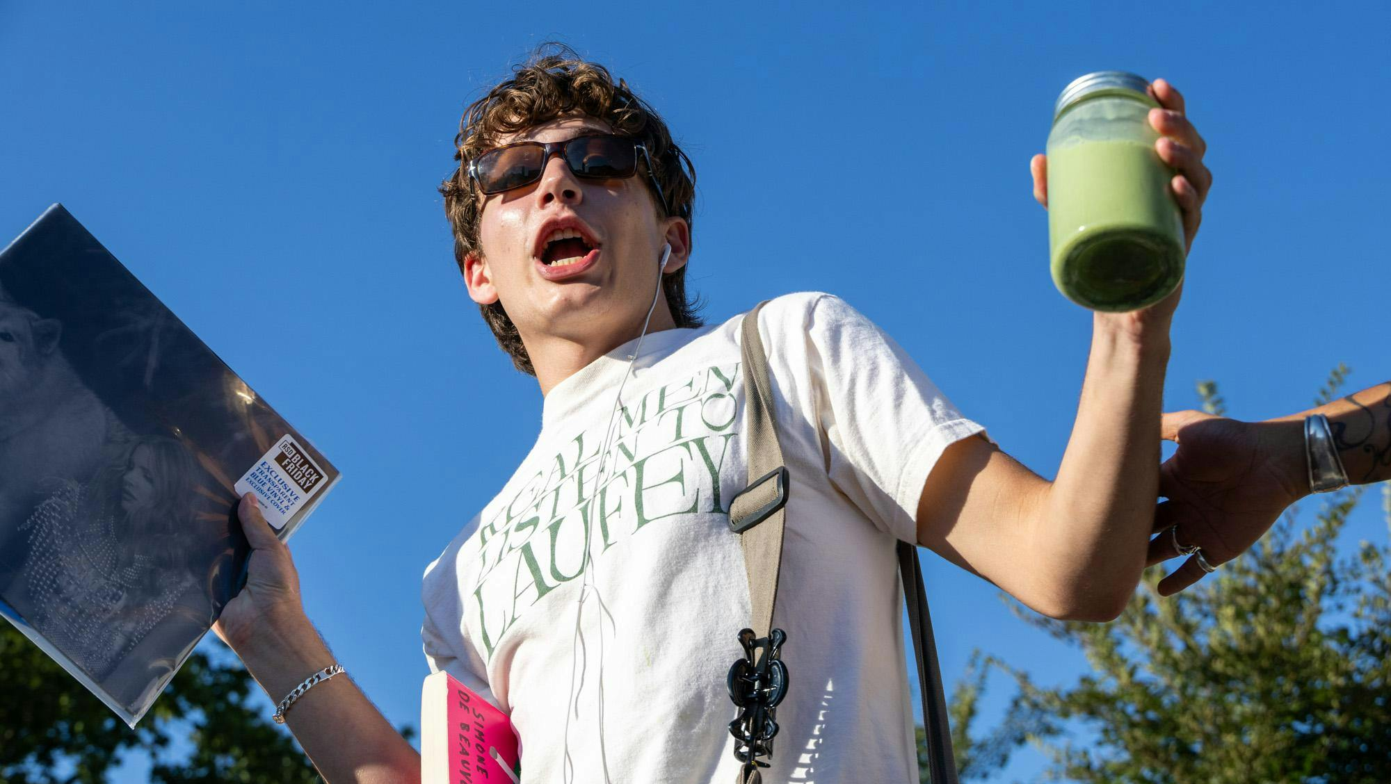



Performative Male Memes
Challenging the authenticity of consumers’ identity projects, reinforcing gender stereotypes
Dr. Samuel Haddad-Bacry
Lecturer, School of Arts and Creative Technologies
University of York
Dr. Alexandre Nassar
Associate Professor, Institut de Recherche en Gestion
Gustave Eiffel University

Slide 2
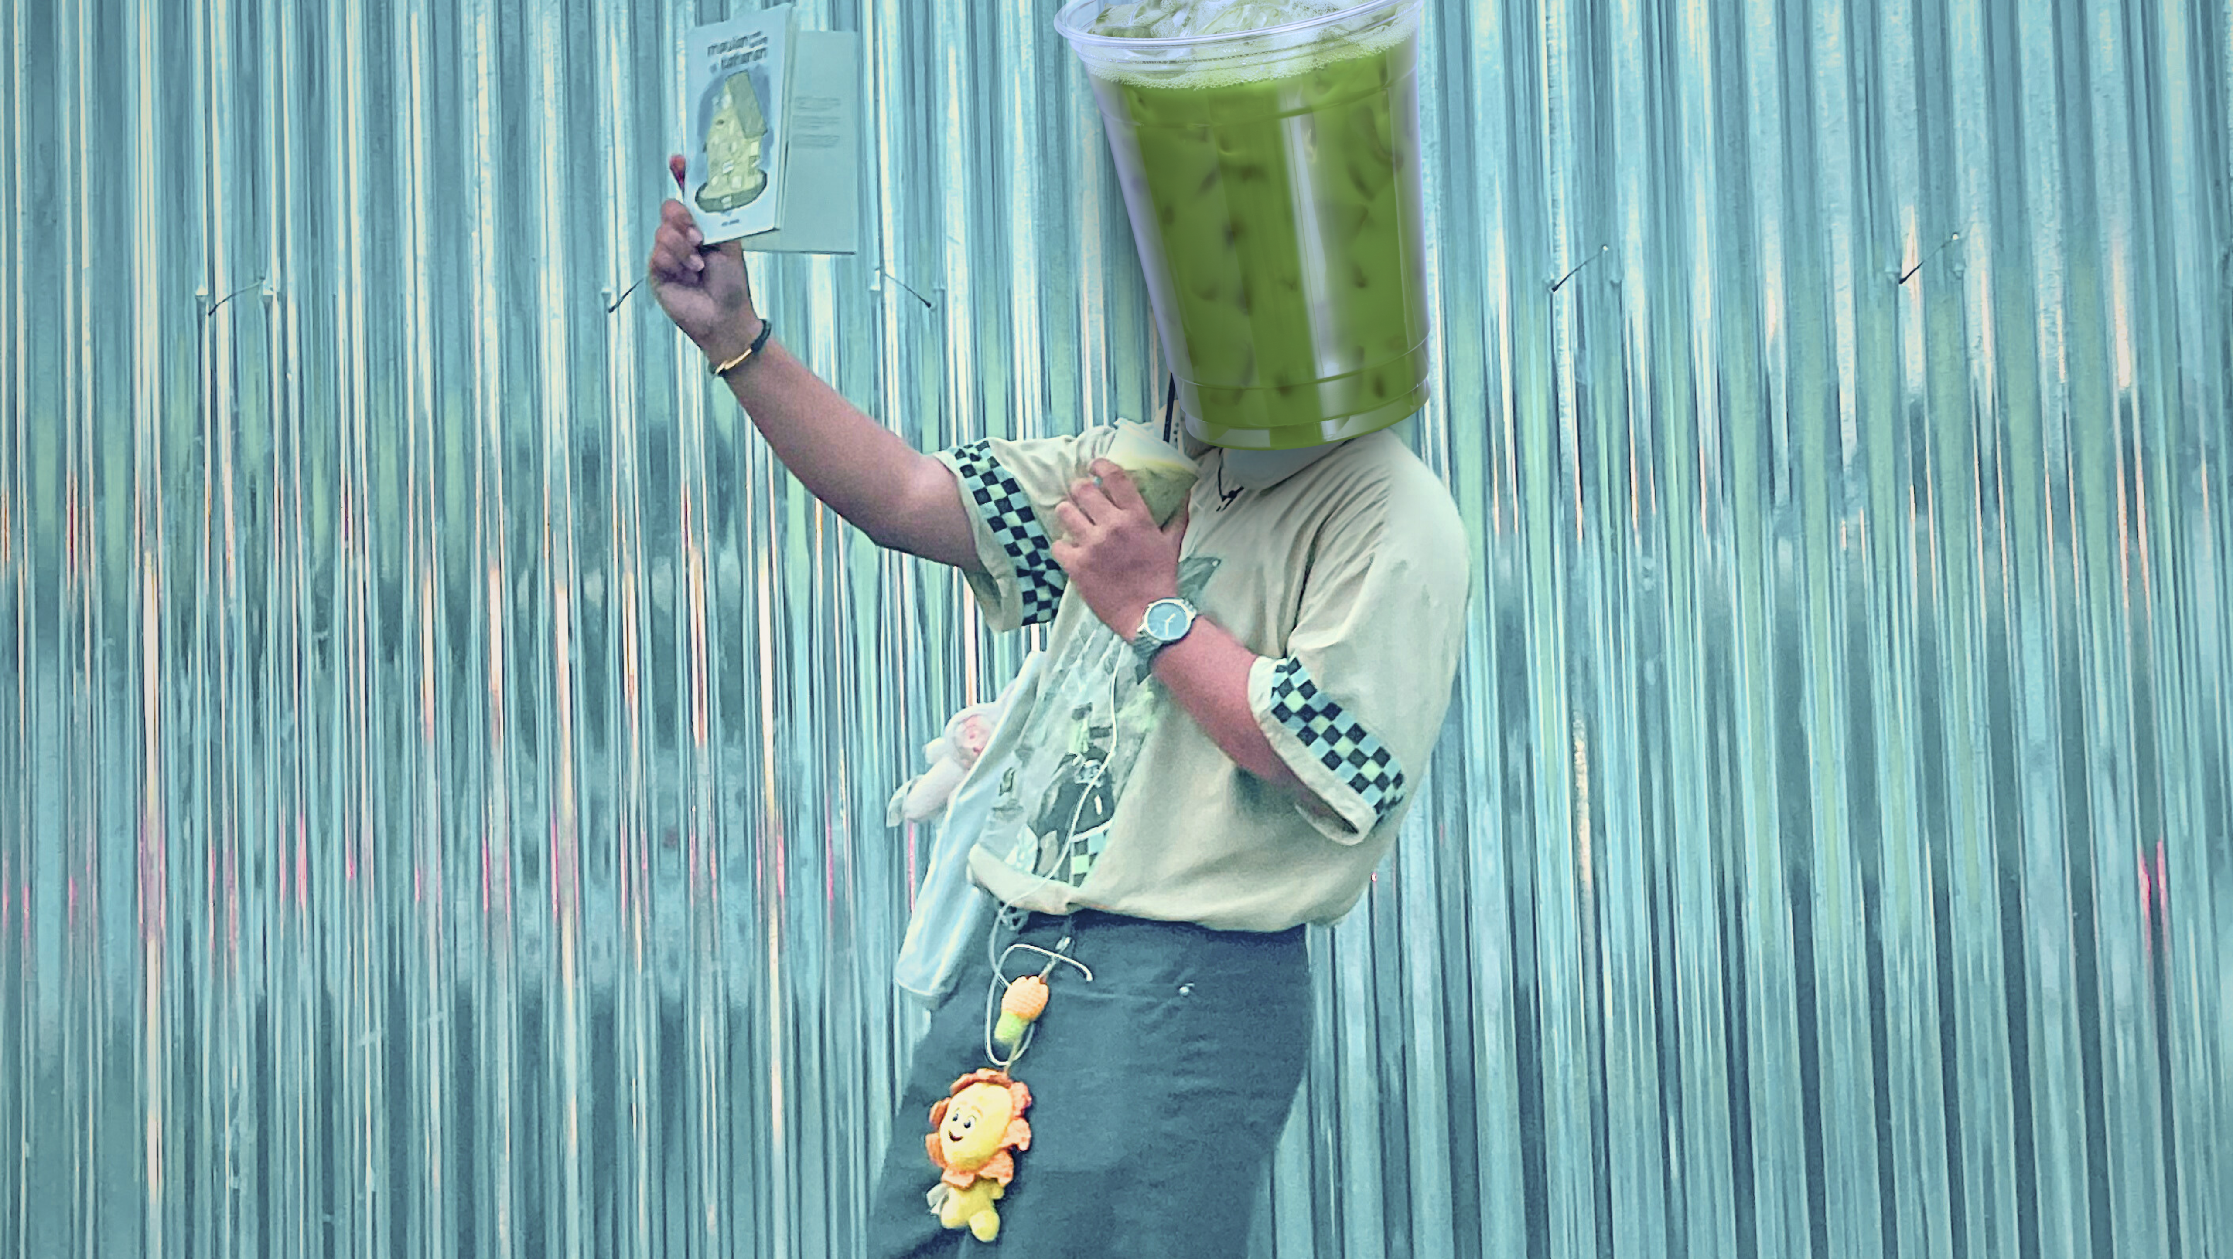
THE CONTEXT

Slide 3

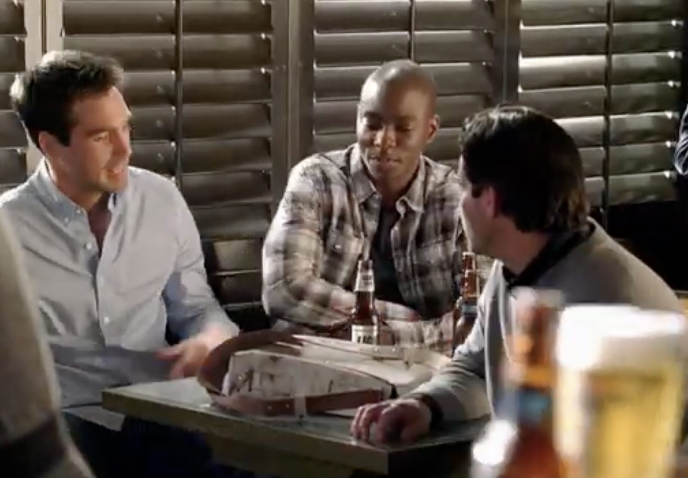
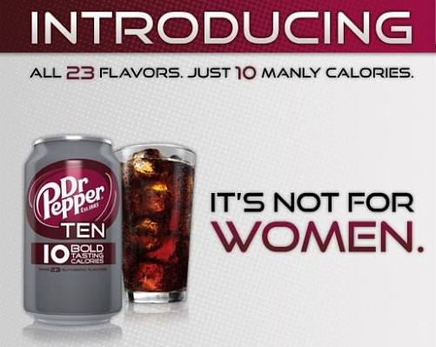
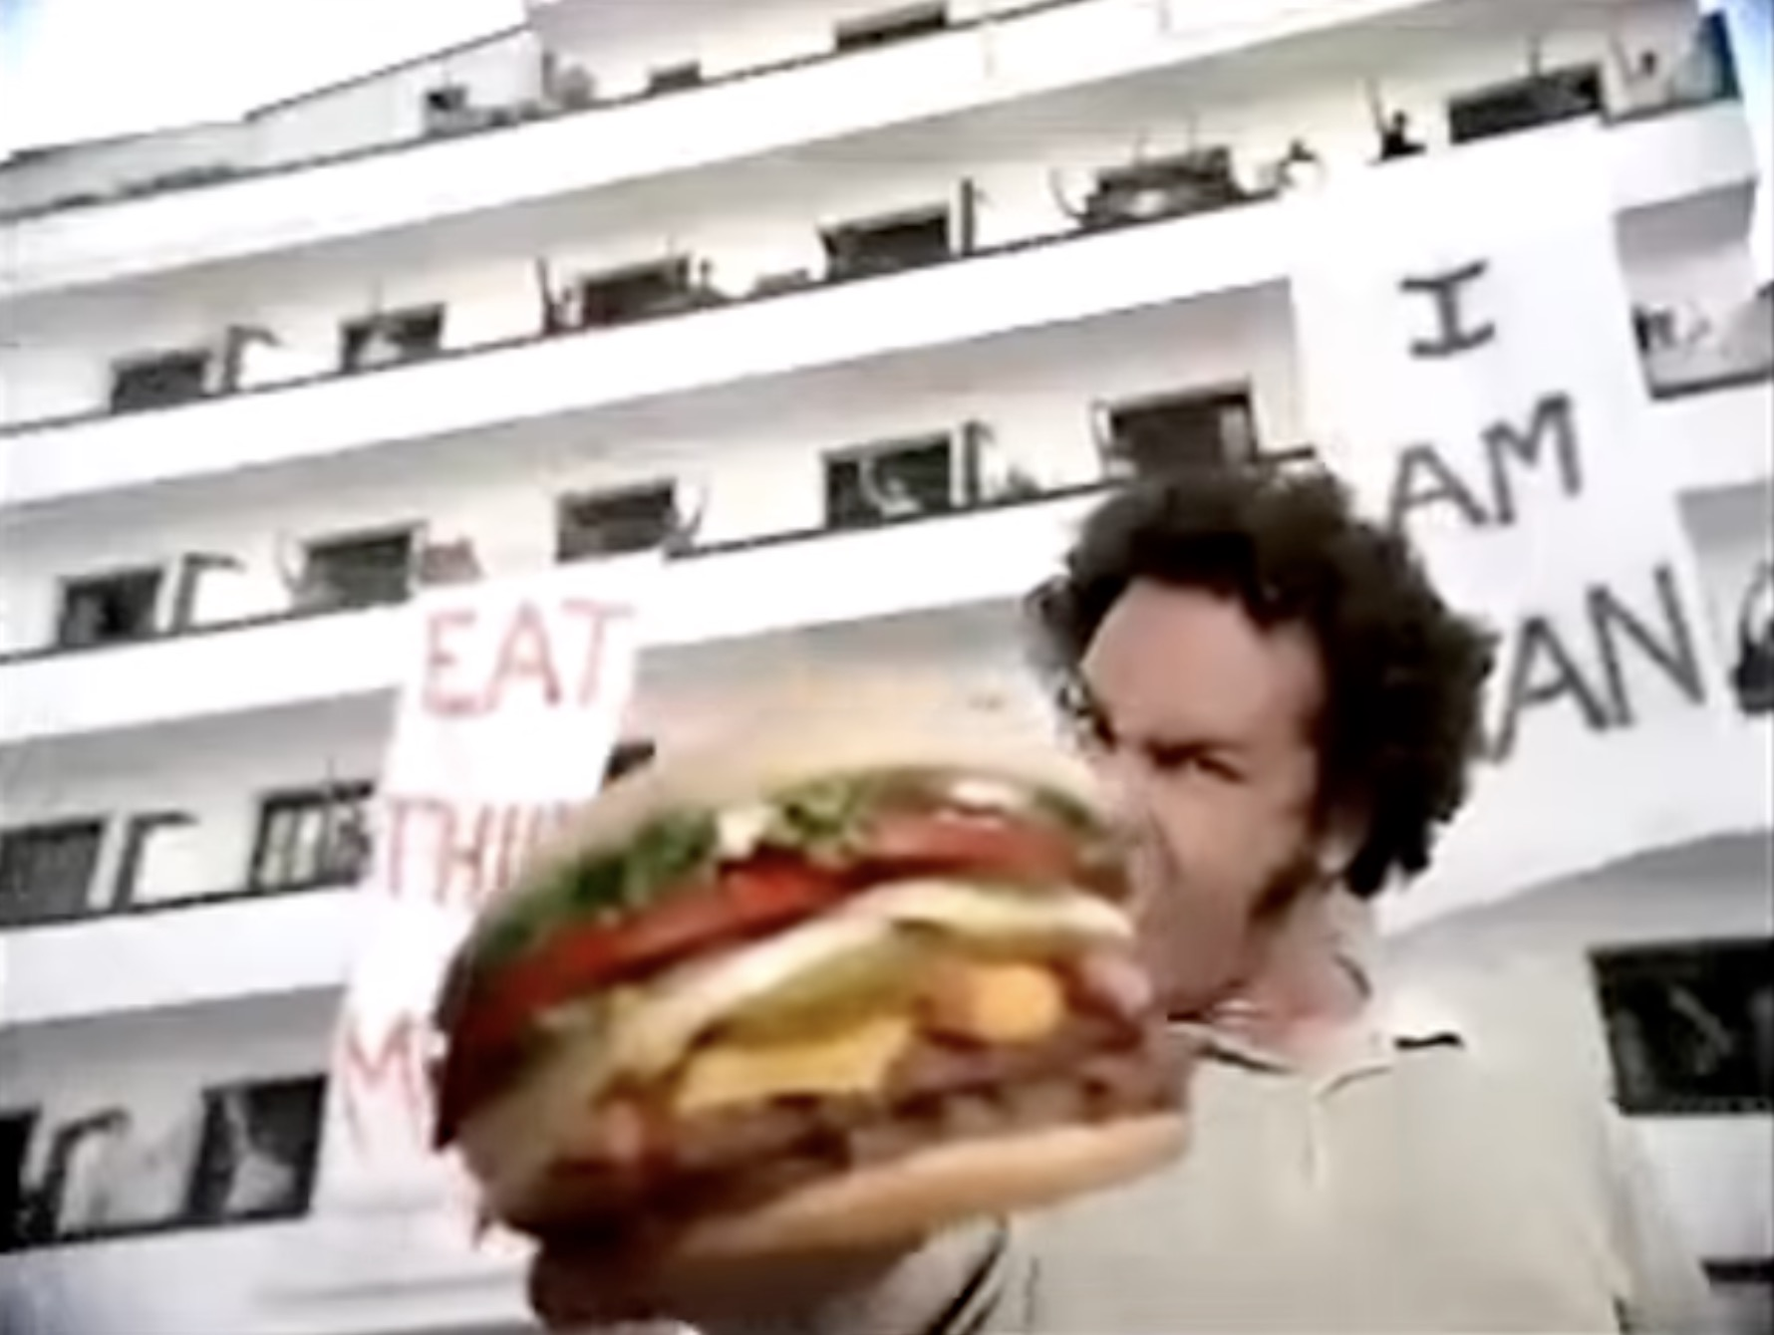
Imagine a world in which men…
I’ll get a Miller Lite
Sure, I’ll watch your
purse!
It’s not a purse, it’s a carry-all!
…would be mocked for consuming feminine things
Notes:
Initially, I was looking at examples much before the Me Too movement, such as the Marlboro Man era, but I realised that advertisements from the last 20 to 25 years did the trick.
From left to right:
- A Miller Lite Beer advert in which the man ordering a light beer is mocked for carrying a « purse »
- A Dr Pepper 10 Lite Soft Drink advert, linking low-calorie soft drink consumption to women
- A Burger King advert in which the man refuses a quiche to eat a manly burger

Slide 4
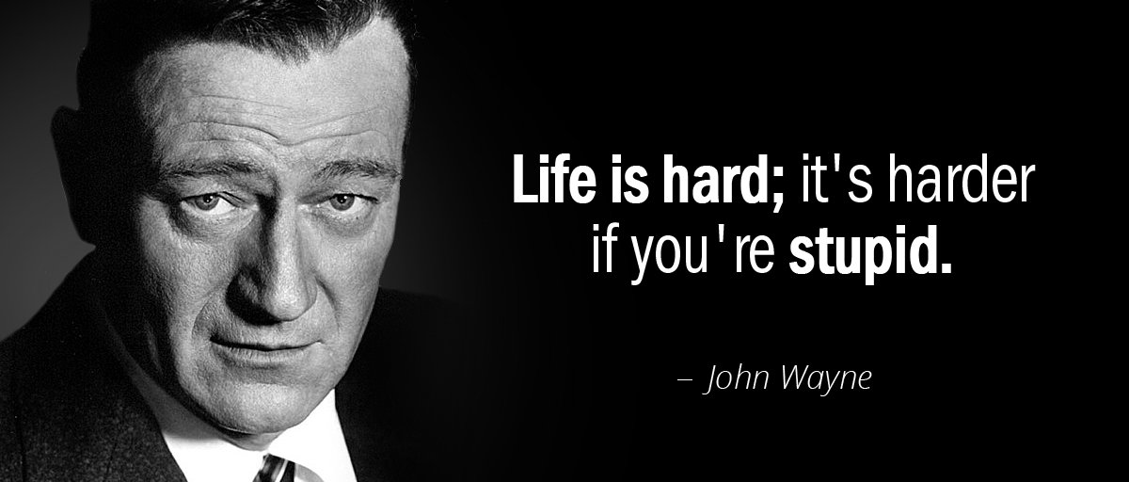
In the same world, men consuming feminine products…
AS JOHN WAYNE
PUTS IT:
…would do so deceptively to seduce women!

Slide 5
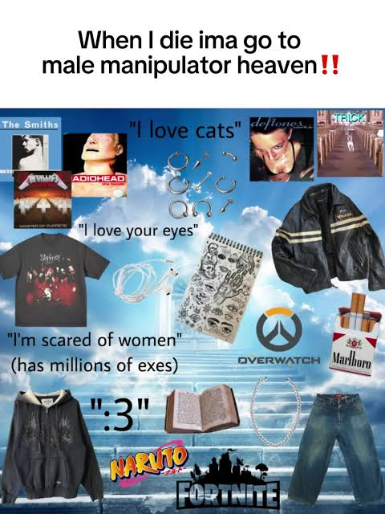
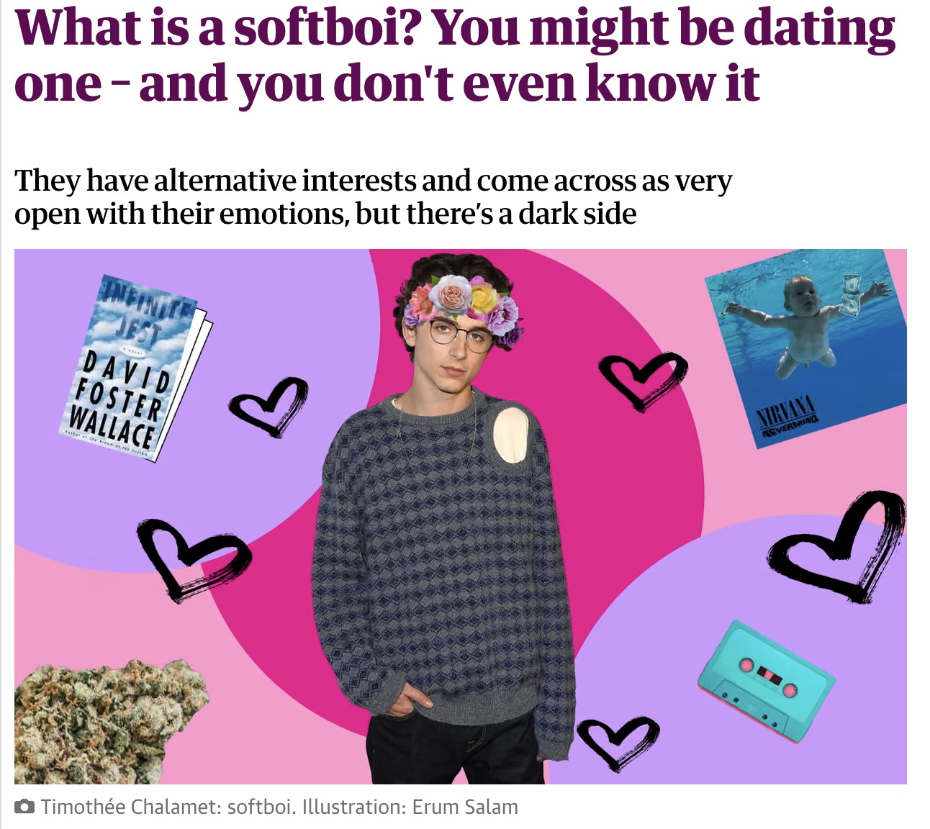
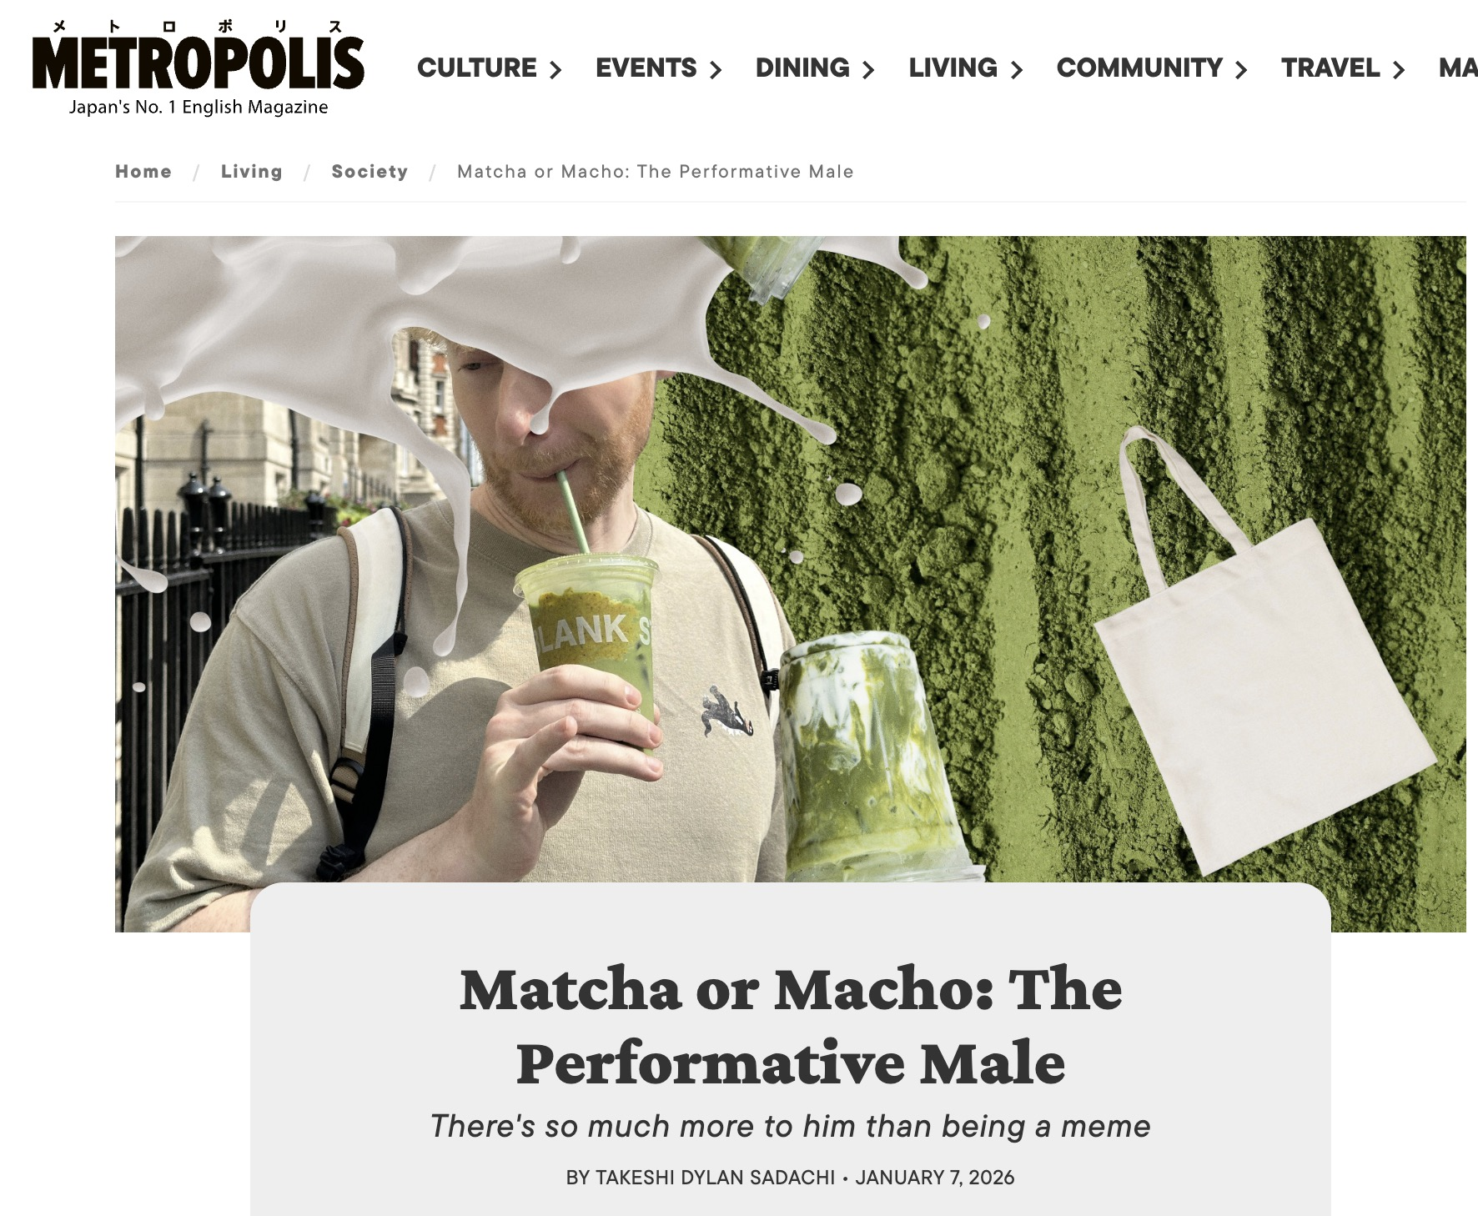
THE CONTEXT
PERFORMATIVE MALES AND THEIR MEMES
Performative males memes emerged in the summer of 2025.
As “men who try too hard to look like feminists” (Connolly, 2025), they stem from a lineage of other forms of non-virile masculinity linked to manipulative seduction.
2015-2019
2025-
2020-2024
Notes:
From left to right:
- an article on the Guardian
- a video on TikTok
- Metropolis, Japan’s number one English magazine

Slide 6
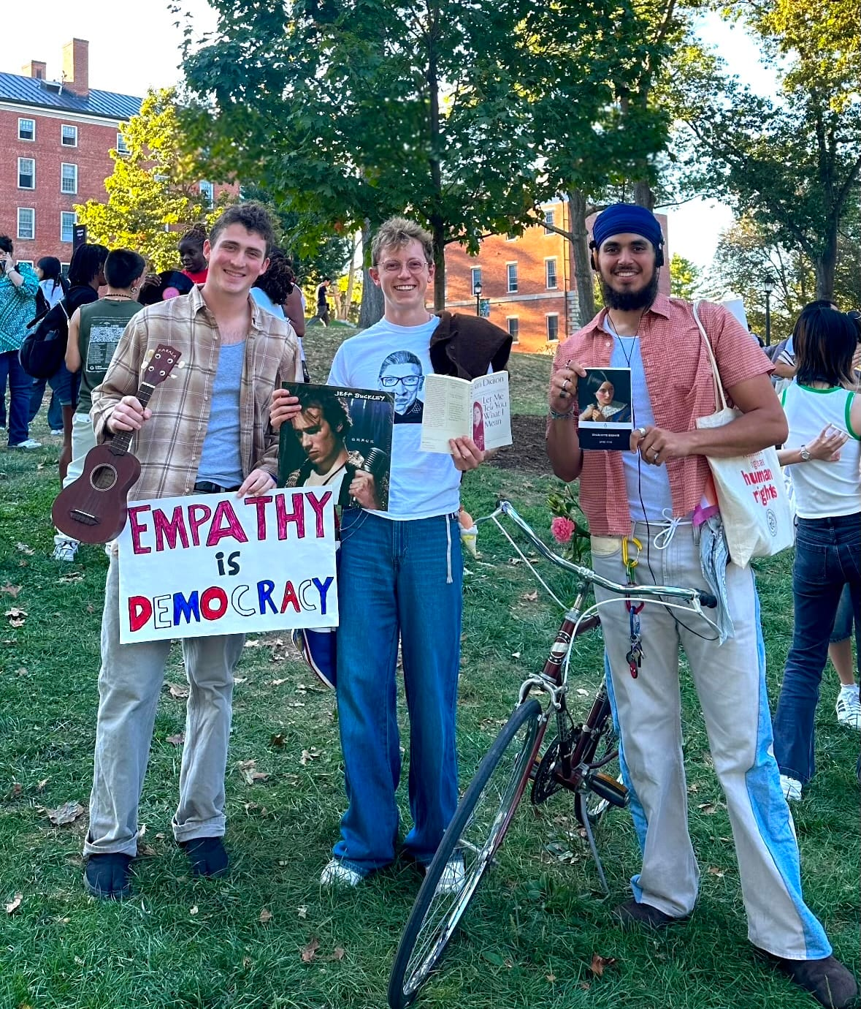
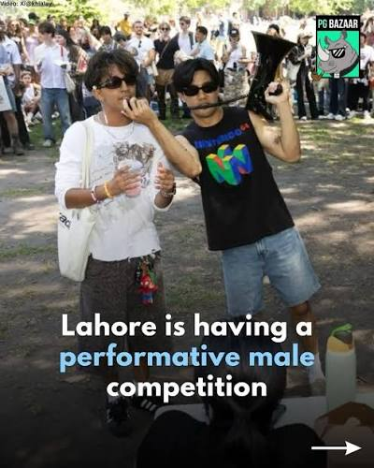
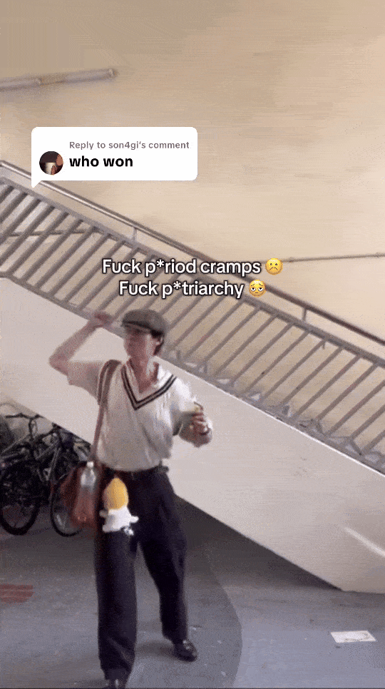
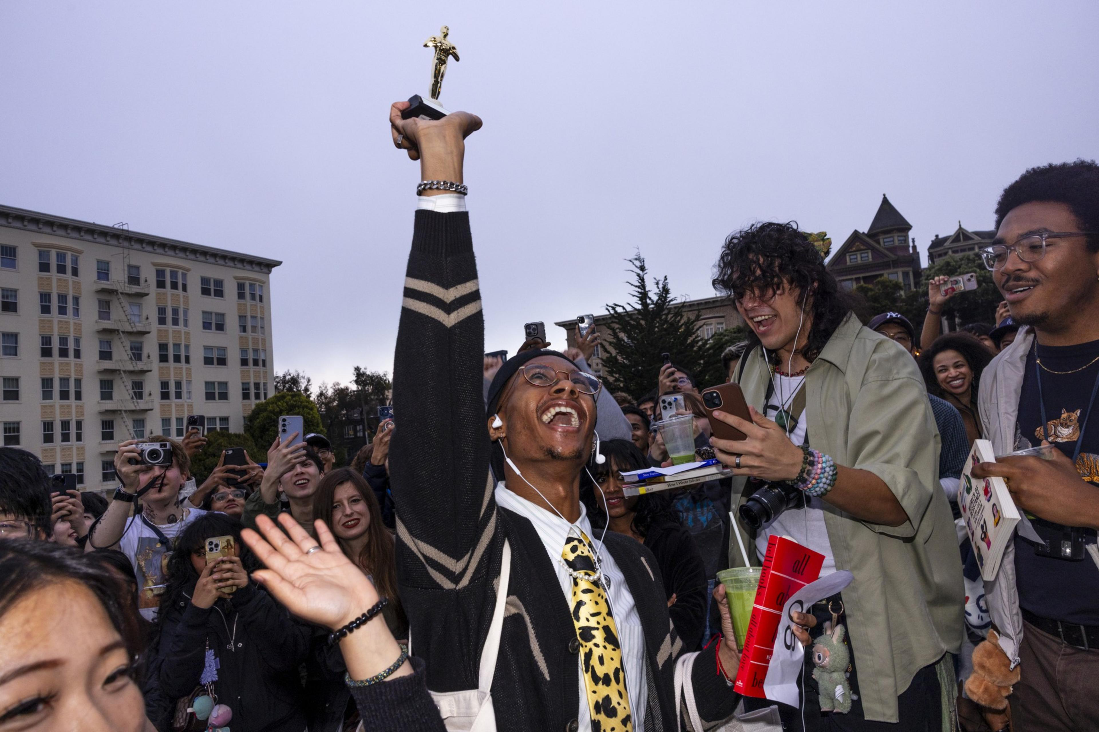
COMMON THREAD
GOODS SIGNALS ALTERNATIVE FORMS NON-GENUINE MASCULINITY
Several ‘‘Performative male contests’’ sprouted in the Summer of 2025 across the world, from New York to Lahore, passing through Singapore or London.
Just like other forms of alternative non-virile masculinity, consumer goods and discourses were used as signals.

Slide 7
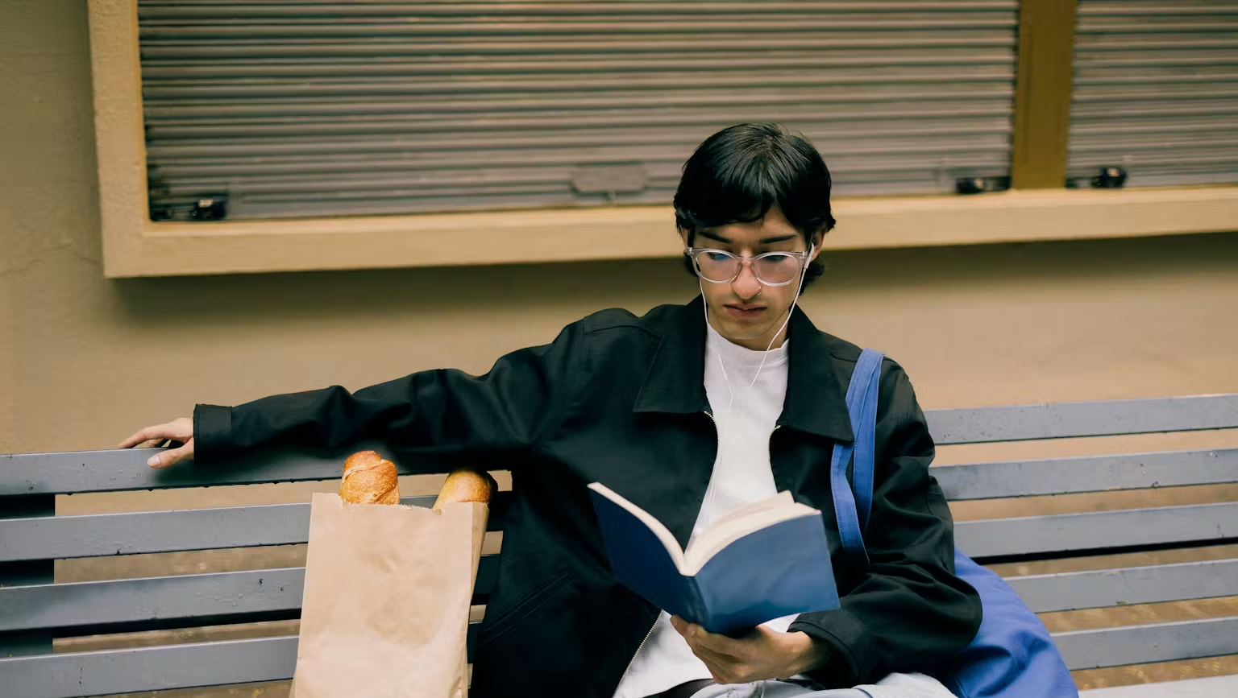
THEORETICAL BACKGROUND

Slide 8
CONSUMPTION & IDENTITY
SIGNALLING ONE’S IDENTITY THROUGH ONLINE CONSUMPTION
Consumers are ‘identity seekers and creators’ (Arnould & Thompson, 2005) who shape and express their selves through offline (Belk, 1988) and online (Belk 2013; 2016) consumption.
Consumers may have ambivalent feeling about products (Hogg et al. 2009; Dunn et al. 2025).
They express their identities through their choices and non-choices (Hogg and Michell 1996; Bourdieu 2010).

Slide 9
CONSUMPTION & GENDER
CONSTRUCTING GENDER IDENTITIES THROUGH CONSUMPTION PERFORMANCES
Gender = the social relations and practices arising from the reproductive differences of our bodies (Connell 2010).
Gender identity is expressed through consumption practices (Gurrieri and Drenten 2025; Kacen 2000).
Gender performativity (Butler, 1999, 2010) | Gender performance (West and Zimmerman 1987)
Gender is constructed by the ‘‘very expressions that are supposed to be its results’’ (Butler, 1999 p.33) The performances that define gender are deemed natural since they are habituated and internalized throughout socialisation. | Gender is ‘’done’’ by recognizing, implementing, and legitimizing social differences and roles (West and Zimmerman 1987). Gender would be a more playful and free part of consumers’ identity assemblages.
Notes:
We still have to implement Goffman here.

Slide 10
MASCULINITY & AUTHENTICITY
NAVIGATING BETWEEN HEGEMONIC AND NON-HEGEMONIC MASCULINITIES
Masculine identities take many forms according to their compliance/non-compliance to traditional gender norms.
Hegemonic masculinity is the set of practises legitimizing that social order (1995; Connell & Messerschmidt, 2005).
Men can perform different strategies to negotiate their masculinities:
Embracing subordinate masculinity (Bridges and Pascoe, 2014, Barry & Philips, 2016)
Humor (Hein and O’Donohoe, 2014)
Contextual adaptation (Bird, 1996; Flood, 2008)
This and our context brings questions about the perception of authenticity in online gender practices.

Slide 11
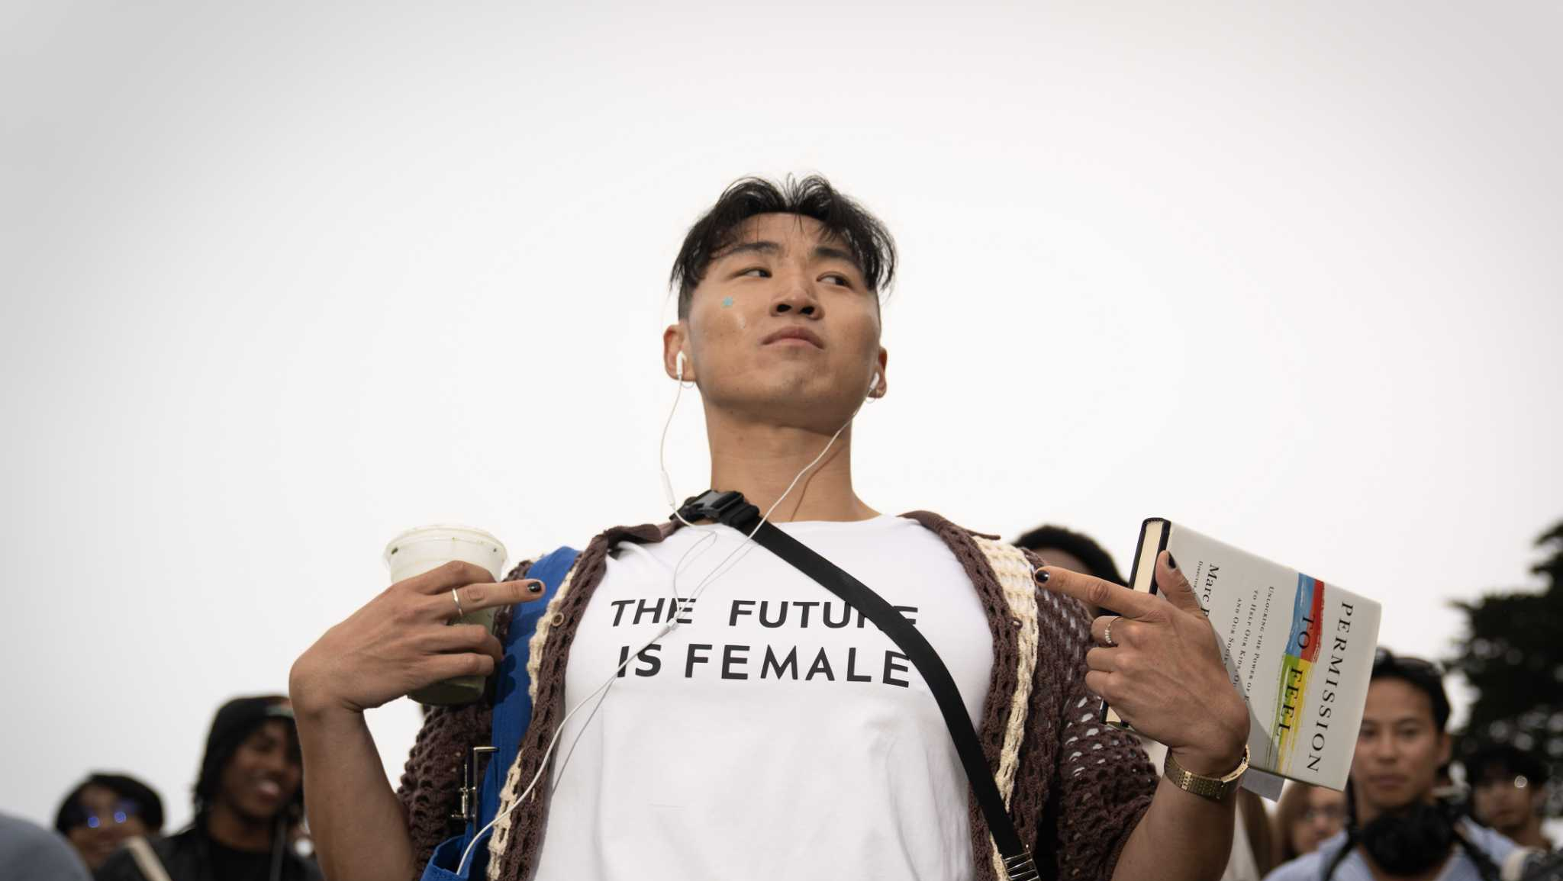
RESEARCH QUESTION

Slide 12
HOW CAN THE STEREOTYPE OF THE PERFORMATIVE MALE AND THEIR PRODUCT PANOPLY INFORM US ON THE CONTESTATION AND RENEGOTIATION OF MALE IDENTITY PROJECTS?
Notes:
The performative male, as a recent male identity stereotype, has not yet been studied in the field of consumer research. It represents a marginal identity that borrows feminine codes, but its performance raises questions among internet users who see it as lacking authenticity. By exploring how online memetic representations of performative males are promoted, as well as the stereotype of the products they use, we seek to better understand how this gender identity is contested, questioned, and stigmatized, influencing choices and anti-choices in male identity projects

Slide 13
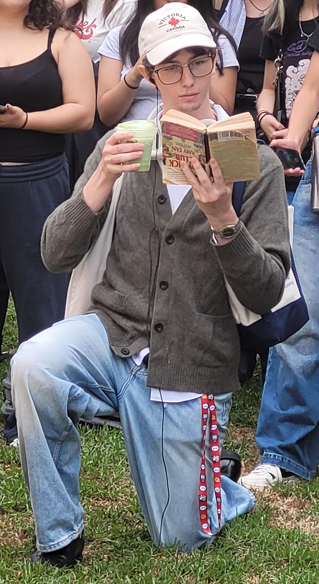
METHODOLOGY

Slide 14
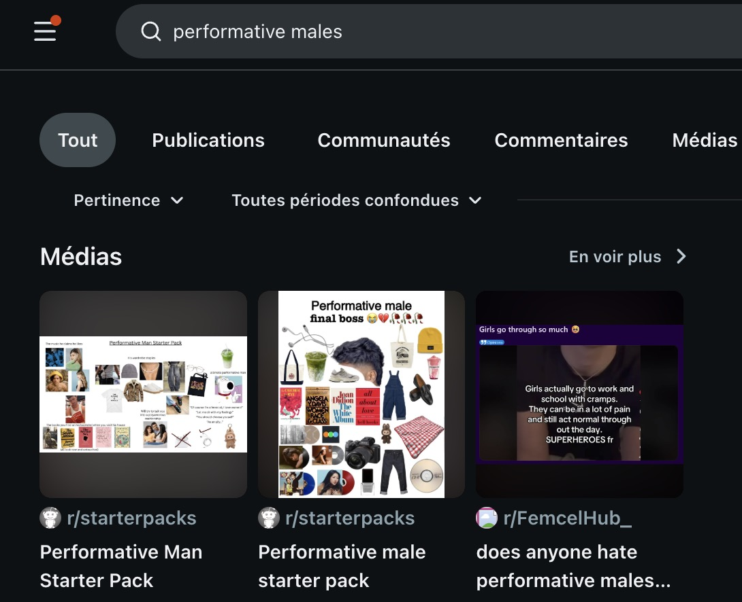
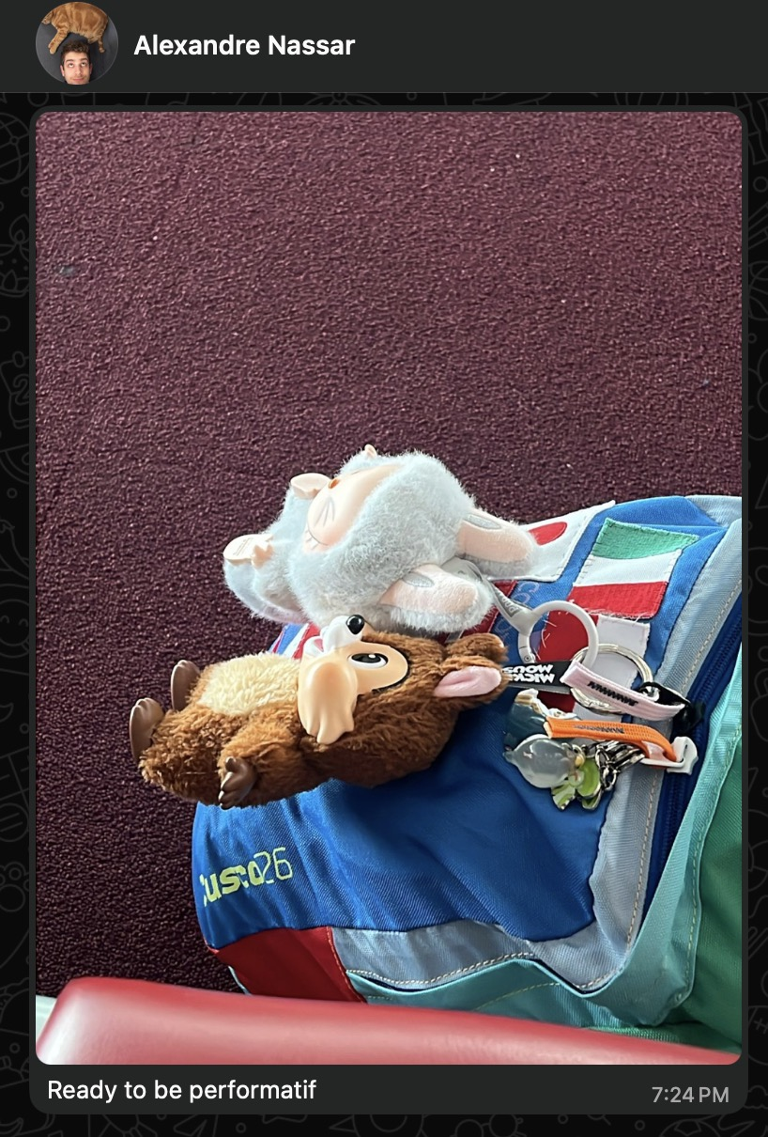
NETNOGRAPHY
Studying performative Male Memes on the internet
Netnography highlights the complexity of consumer identities and considers images, videos, online posts, tags, and clicks as “communicative performances” (Kozinets, 2015 p. 458).
Exploring the exchange and reception of memes on social networks such as Reddit, Instagram, and YouTube.
We studied (Shifman, 2013):
Their contents, ideas and ideology
Their format
The position of the communicator
We followed Kozinets’ advice and fully immersed ourselves in the environment.
Notes:
In ethnography, Kozinets prompts the researcher to become part of the studied environment.

Slide 15
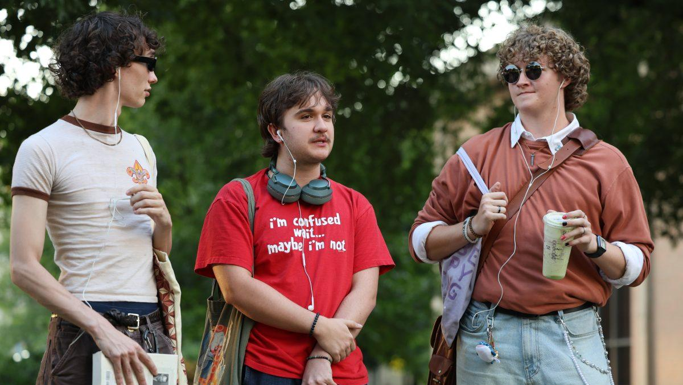
FINDINGS

Slide 16
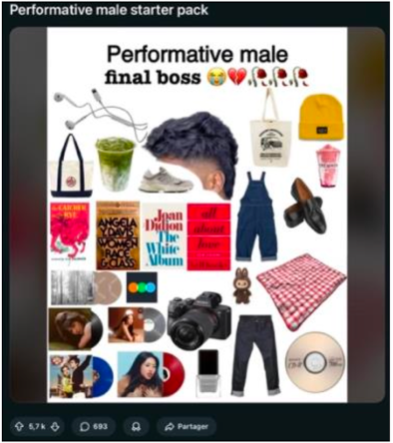
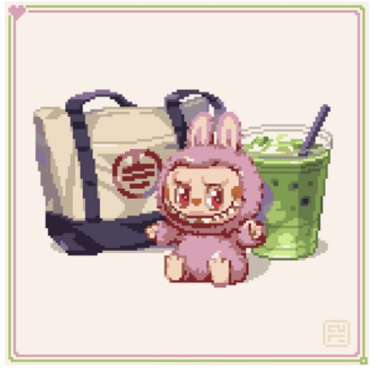
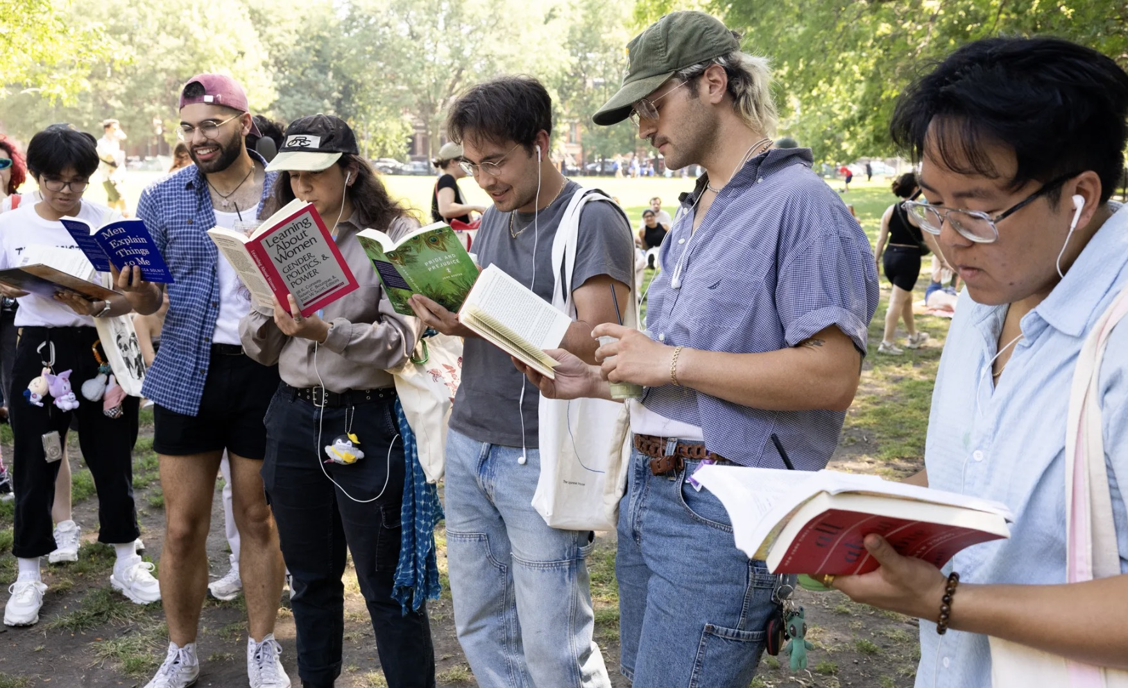
IDENTIFYING
The product panoply of the performative male as a signal
Performative males are defined and stereotyped by the panoply of products that they exhibit a positive attitude to and that they consume.
We often saw memes depicting performative males and the visible elements of their extended selves.
They serve a purpose of virtue signaling.
A comment spotted a missing item:
“Where’s the women's health book? 😢”
Notes:
We found many performative male starter pack memes, such as this one:
Content: wired earphones, a matcha drink, a retro sneaker, a tote bag, feminist books… Depiction as the panoply of the final boss with emojis crying, a heartbreak and dead flowers. Remindful of the male manipulator and the softboi’s tendency to exhibit sensitivity.
Format: an image with a little bit of text posted on the subreddit r/starterpacks, A subreddit on which other stereotypes of consumers' experiences or online spaces are mocked with the same format.
Position of the communicator: potentially ironic, but hard to say. The only thing that we knew about them is their profile picture (an 18 pink logo) and the fact that they are a regular poster on Reddit.

Slide 17
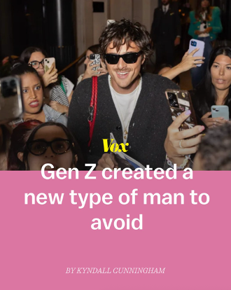
MOCKING & DENOUNCING
CALLING OUT disingenuous consumption performancE
The contents of the memes and the reactions to them were often ambiguous.
Most were humorous, either to denounce the disingenuousness of the consumption performances of performative males.
UniqueAthena: “He's manipulating me right now i can feel it”
sonnet.5 (Meme creator): “Is it working?”
soniaaa: “Yes”
– Extracted from a meme found on Instagram
Notes:
On the image on the right, a user commented on the Starter Pack meme, posting a picture of their room with vinyl artwork on the walls (mostly by female artists) and a bottle of alcohol.
The original publisher of the Star Pack meme that we showed on the last slide identified them as the final boss. We also see that the consumption items are perceived as a red flag, just as booze would be.

Slide 18
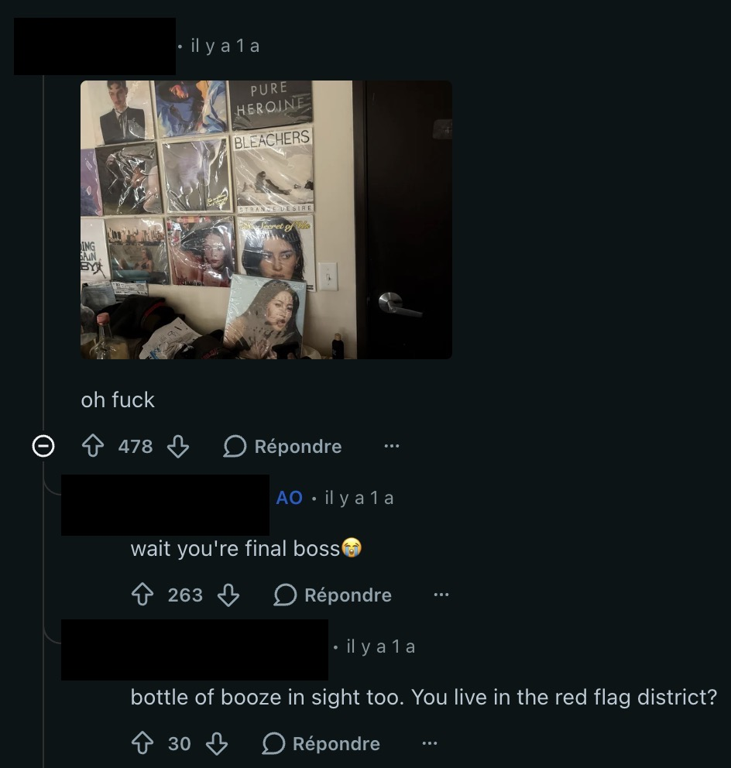
DOUBTING & COPING
The phenomenon brought doubts and IDENTITY CRISIS, solved by coping strategies
On memes, the adjective ‘‘performative’’ is not intended to refer to gender performance, but disingenuous or inauthentic gender performance aimed at luring women.
This generated anxieties of being toxic or displaying too many ‘‘red flags’’, that some solved by reassurance or hour.
“So, when a man reads women, educates himself, avoids wasting plastic bags, and owns his music—is that really a reason to mock him?”
‘‘It's not making fun of men who GENUINELY like that stuff, it's making fun of men who pretend to like that stuff just to get women. Get it right! 💋 ”
— Comments to the @voxdotcom Instagram post
Notes:
On the image on the right, a user commented on the Starter Pack meme, posting a picture of their room with vinyl artwork on the walls (mostly by female artists) and a bottle of alcohol.
The original publisher of the Star Pack meme that we showed on the last slide identified them as the final boss. We also see that the consumption items are perceived as a red flag, just as booze would be.

Slide 19
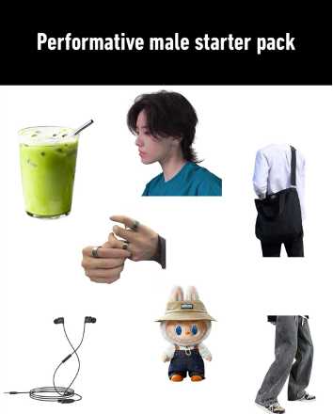
RIDICULING & MASCULINIZING
Spaces for the EXPRESSION of traditional gender norms
To some, the calling out of performative males’ ‘‘disgenuineness’’ was actually the reflection of traditional gender norms.
It ultimately resulted in collective reconstructions of the scope of masculine identities.
“It seems to turn into something that's reinforcing gender norms and saying men/women can only have certain interests under the guise of being ‘woke’. It may be a controversial opinion, but I guess I don't mind it even if it is ‘performative’”
– A Reddit User on a Feminist channel
Comment 1: Is this International problem?
Comment 2: Bro that’s zero testosterone nothing else 😂
Comment 3: 250mg of Testosterone should fix this issue.

Slide 20
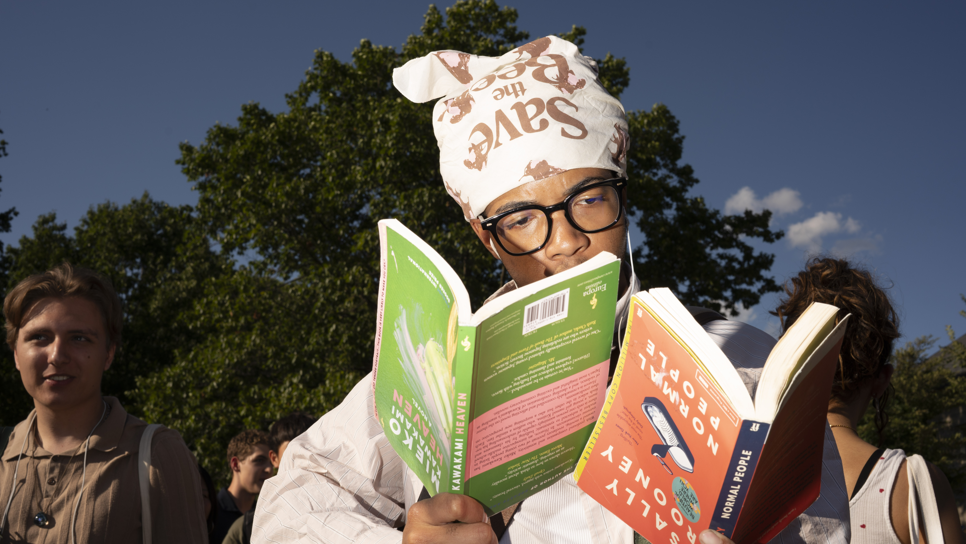
DISCUSSION

Slide 21
SUSPICIOUS MINDS
HYBRID GENDER IDENTITIES OR STRATEGIG APPROPRIATIONS?
Our findings align with Bridges and Pascoe's (2014) concept of hybrid masculinities.
Performative males incorporate in their extended selves consumer goods and experiences traditionally associated with femininity, sensitivity or feminist culture — Labubus, feminist books, tote bags — or retro items.
This is a strategy opposed to the gender-bending gap identified by Brough et al. (2016):
Not embracing green practices to express virility
vs
Embracing feminine practices to express virility
Notes:
Virility is expressed through traditional gender norms by either being strong or careless or seducing women.

Slide 22
TENSIONS
THE HOMOSOCIAL/HETerosocial double bind
Our results extend Bird (1996) and Flood (2008) observations that men adapt their gender performance depending on their audience and show how their audience reacts to them.
Genuine performative males are in an impossible position:
Performative males are simultaneously accused of manipulating women through fake progressivism and attacked by men for abandoning hegemonic masculinity.
The phenomenon can be an illustration of how social media reinscribe gender norms (Schroeder, 2021).

Slide 23
WHO ARE WE TRULY?
Questioning the authenticity of gender performances in a post-postmodern society
We extend the research of Kondakciu et al. (2022) on the construction of consumers’ “authentic selves.”
It may be that in our post-postmodern society, with a renewed quest for authenticity (Cantone et al., 2019):
One cannot simply ‘‘do’’ gender (cf. West and Zimmerman 1987) far away from hegemonic masculinities without raising suspicions.
Traditional gender norms may feel so natural and internalized (cf. Butler, 1999, 2010) that we have difficulty accepting others that divert from ours.
What is an authentic identity if not a performance?

Slide 24
IMPLICATIONS

Slide 25
Beware of contaminated products
Labubu dolls, matcha, tote bags signal progressive values yet mark male consumers as posers — stigma by association
PLATFORM SPECIFIC POLICING AND AFFORDANCES
Feminist Reddit enabled nuance; Instagram and 9gag reinforced hegemonic masculinity
Contested masculinity
more research needed on the ‘‘performative male’’ stigma, hybrid gender identities and suspicions of inauthenticity/disingenuousness

Slide 26
MERCI! ANY QUESTIONS? FEEDBACK?

